Slide 1
Introduction to Automated Testing & Katalon Recorder

Slide 2
Learning Objectives
By the end of this lecture, you should be able to:
Explain what test automation means.
Describe the basic automation workflow.
Identify a few benefits and challenges of automation.
Recognize the main purpose of Katalon Recorder.
Create and execute a simple web test using recording.
Identify whether a test execution passed or failed.

Slide 3
Introduction to Software Testing
Definition: Software testing is the process of evaluating and verifying that a software application or system meets the specified requirements. It involves executing the software to find defects, ensuring it performs as expected.
Example: Testing the checkout feature of an online shopping website to ensure customers can add products to their cart, place an order successfully, and receive appropriate messages when required information is missing or invalid.
Purpose: Identify bugs, ensure quality, and verify that the software is functioning as intended.
Types of Testing:
  Manual Testing
  Automation Testing

Slide 4
What is Manual Testing?
Definition: Manual testing is the process of manually executing test cases without the use of automation tools. Testers follow predefined test cases and use the software like an end-user to identify bugs.
Example:
  Gmail Compose Email: Composing an email, entering a recipient, adding a subject and message, and clicking Send to verify that the email is sent successfully and appears in the Sent folder.
  Testing a Form on a Website: A tester manually fills out and submits a form on an e-commerce site like Amazon to ensure the data is processed correctly.

Slide 5
What is Automation Testing?
Definition: Automation testing is the use of software tools and scripts to automatically execute test cases, compare actual results with expected results, and report test outcomes. Tools such as Selenium, Cypress, and Katalon Studio can automate repetitive, time-consuming, and regression testing activities.
Example:
  Daraz Product Search: Automatically searching for a product, applying price and category filters, and verifying that the displayed products match the selected criteria.
  Foodpanda Order: Automatically selecting a restaurant, adding food items to the cart, changing quantities, and verifying that the order total is calculated correctly.
  Yango Ride Booking: Automatically entering pickup and destination locations and verifying that available ride options and estimated fares are displayed correctly.

Slide 6
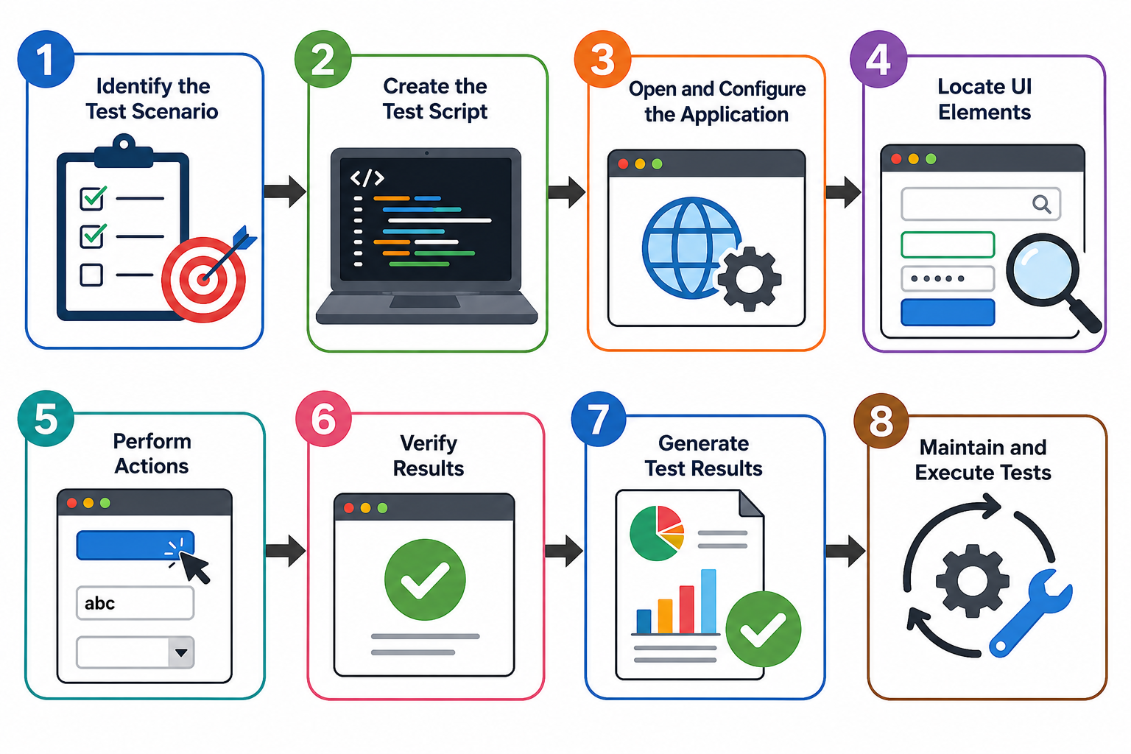
Automation testing workflow

Slide 7
Manual vs. Automation Testing
Aspect | Manual Testing | Automation Testing
Execution | Tester performs steps manually. Example: Checking a Daraz search manually. | Scripts perform the steps automatically. Example: Repeating the same Daraz search automatically.
Time | Slower for repeated tests. Example: Checking 100 products one by one. | Faster for repeated tests. Example: Checking 100 products automatically.
Cost | Lower initial cost. Example: No automation setup required. | Higher initial cost. Example: Time and resources needed to create scripts.
Flexibility | Easy to change and explore. Example: Testing a newly added Foodpanda feature. | Changes may require script updates. Example: Updating a script after a checkout redesign.
Human Error | More likely during repetitive tasks. Example: Missing a field while checking many forms. | Fewer repetitive mistakes. Example: Checking the same form fields consistently.
Reusability | Tests are repeated manually for each release. Example: Rechecking the checkout process after every update. | Scripts can be reused for every release. Example: Running checkout tests scripts after each update.

Slide 8
Benefits of Automated Testing
Faster Execution
  Example: Running 200 regression tests on Daraz in minutes instead of spending hours testing them manually.
Increased Coverage
  Example: Testing Foodpanda website across multiple browsers and screen sizes in a single test run.
Reusability
  Example: Reusing the same Daraz checkout test script after every new application release.
Reliability
  Example: Automatically verifying the Yango fare calculations every time without missing a step.
Cost-Effective
  Example: Creating a JazzCash transaction test once and reusing it for hundreds of test runs without repeating the manual effort.

Slide 9
Challenges of Automated Testing
Initial Setup Time and Cost
  Example: Setting up a Selenium framework can take days before actual testing begins.
Maintenance Overhead
  Example: When a login button's location changes, all related test scripts must be updated.
Not Suitable for UI/UX Testing
  Example: Automation can't test how "user-friendly" a design feels or how intuitive navigation is.
Skilled Workforce Required
  Example: Test automation tools like Selenium require knowledge of programming languages like Java or Python.
False Positives and Negatives
  Example: A test might fail due to slow internet, not because of a real bug in the application.

Slide 10
Getting started with Automation using KATALON Recorder

Slide 11
Overview of Katalon Recorder Extension
What is Katalon Recorder?
  A lightweight browser extension for record-and-playback testing.
  Supports Chrome, Firefox, and Edge.
  Easy to use, even for beginners.
Why Use Katalon Recorder?
  No need for complex programming.
  Record and export test scripts to Selenium, Katalon Studio, etc.
  Supports multiple commands for element interaction.

Slide 12
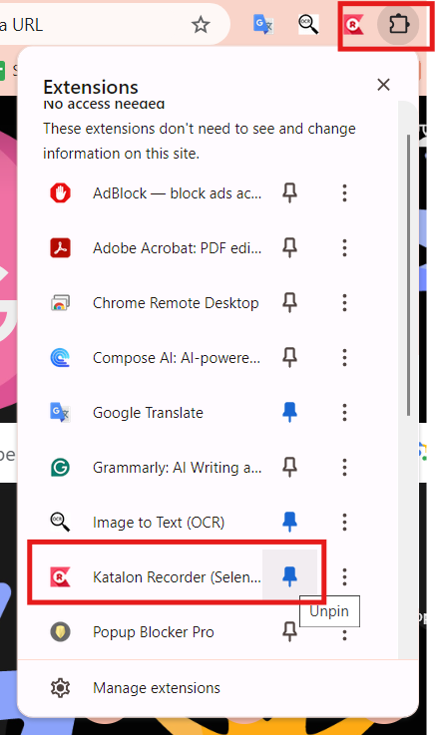
Installing Katalon Recorder
Step-by-Step Guide:
Open Chrome or Firefox.
Go to the Web Store or Add-ons page.
Search for Katalon Recorder and click Add to Browser.
Pin the extension for easy access.

Slide 13
Features of Katalon Recorder
Record-and-Playback:
  Captures user actions for automated testing.
Assertions:
  Verify elements or page states.
Multiple Export Options:
  Export to Selenium WebDriver, Katalon Studio, etc.
Execution of Test Suites:
  Combine multiple test cases into a test suite for execution.

Slide 14
Using Katalon Recorder - Example
Example: Test Steps for Automating a Simple Login Test
Navigate to Automation Exercise.
Start recording.
Click "Login".
Enter test credentials.
  E-mail: sample@user.com
  Password: 123456789
Submit the form.
Stop recording.
Save the test case.

Slide 15
Practice Activity #1
Objective: Create a test case that automates the search functionality of a website.
Test Steps:
  Open Automation Exercise.
  Use Katalon Recorder to record searching for a product.
  Save the test case.

Slide 16
Practice Activity #2
Objective: Create a test suite combining two test cases:
Login Test: Automate login functionality.
Product Search Test: Automate product search.
Task: Record both test cases, combine them into a suite, and run the suite.

Slide 17
Debugging in Katalon Recorder
Common Errors:
  Unrecognized elements or commands.
  Incorrect XPath or CSS locators.
Debugging Tools:
  Pause, resume, and step through test cases.
  Modify recorded steps to correct errors.

Slide 18
Explore Sample Projects
From the sample projects, practice the already recorded test cases and debug them if you encounter any errors.

Slide 19
Limitations of Katalon Recorder
1. Limited Scripting Flexibility
  Example: Cannot handle complex logic like loops or conditions.
  Selenium Benefit: Write custom test logic using programming languages like Java or Python.
2. Basic Support for Complex Test Scenarios
  Example: Difficult to automate file uploads, multi-window, or pop-ups.
  Selenium Benefit: Handle complex scenarios like file downloads, multi-window switching.

Slide 20
Limitations of Katalon Recorder
3. No Parallel Execution
  Example: Test cases run one after another.
  Selenium Benefit: Use Selenium Grid to run tests simultaneously across multiple browsers and platforms.
4. Basic Reporting
  Example: Minimal logs and no detailed screenshots of failures.
  Selenium Benefit: Integrate with reporting frameworks like Extent Reports for detailed test metrics and screenshots.

Slide 21
Conclusion
Summary
  Katalon Recorder is an easy-to-use tool for quick web testing automation.
  It simplifies the process for beginners, offering recording, exporting, and playback options.
Next Steps:
  Apply your recorded tests to real-world scenarios.

Slide 22
Class Takeaways
Practice more examples from the sample projects and try to know about more commands as we did during the lecture.
Don’t forget to practice the xpath examples as discussed during the class.
Do explore, practice and debug the sample projects.

